Slide 2
Notes:
Explain that when sugary food and drinks mix with bacteria (plaque) on teeth, acid is formed. The acid sits on healthy teeth “eating away” the enamel, causing a cavity.

Slide 3
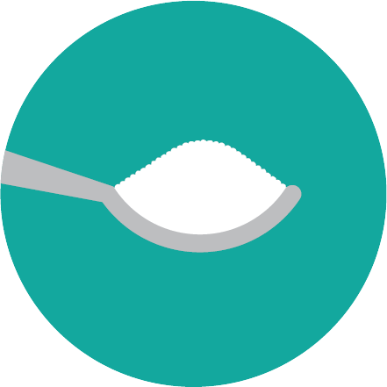
Let’s Talk About Sugar!
Orange Juice
20 oz. serving |12 tsp. of sugar
Chocolate Milk
20 oz. serving |14 tsp. of sugar
Cola
20 oz. serving |16 tsp. of sugar
Notes:
If you drink orange juice with breakfast, chocolate milk with lunch, and a cola after school or with dinner, the amount of sugar consumed from drinks adds up!

Slide 4
Let’s Talk About Sugar!
Yogurt
1 cup serving |12 tsp. of sugar
Ketchup
1 tbs. serving |14 tsp. of sugar
Granola Bar
1 bar serving | 3 tsp. of sugar
Notes:
Some foods have sugar that may surprise you!

Slide 5
Notes:
Introduce the pH scale
We measure temperature with a thermometer
We measure the length of something with a ruler
We measure acidity with the pH scale

Slide 6
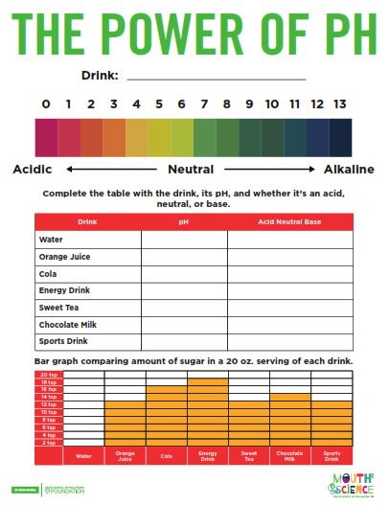
Investigate and
Record
pH: The acidity or alkalinity of a solution
0-6 = Acidic
7 = Neutral
8-13 = Alkaline (Base)
Notes:
Complete pH column in table
Tell students that pure water has a pH of 7
Ask each group what the pH of their drink is and record data

Slide 7
Investigate and
Record
Acid | Neutral | Alkaline
0-6 = Acidic
7 = Neutral
8-13 = Alkaline (Base)
Strong Acid or Weak Acid?
Close to 0 – Strong acid
Close to 7 – Weak acid
Notes:
Complete Acid, Neutral, Base column in table
Tell students that pure water* would measure at a 7, so it is neutral
Ask students if each drink is an acid, neutral or alkaline (base) and record data
*According to Dr. May Nyman, a chemistry professor at Oregon State University, absolutely pure water does not exist due to water’s tendency to absorb substances from its surrounding environment.

Slide 8
How Much Sugar?
Notes:
Move to bar graph and ask students questions about the bar graph
What does the bar graph tell us?
Which drink has the most sugar? How many teaspoons?
Which drink has the second highest? How many teaspoons?
Which drink has the least amount of sugar? How many teaspoons?

Slide 9
Notes:
If you choose to eat or drink foods with lots of sugar and acid, try these tips to keep your teeth healthy
Use a straw – lessens contact sugar and acid have with teeth
Brush your teeth – wait 20 minutes and brush away the sugar and acid.
Drink water – rinse the sugar and acid from your teeth by drinking water.
Chew sugarless gum – Saliva is produced when you chew. The saliva can help remove sugar and acid.

Slide 10
THANK YOU!

